Slide 1
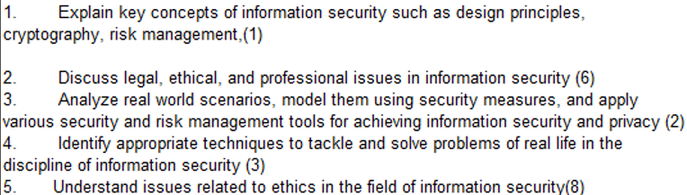
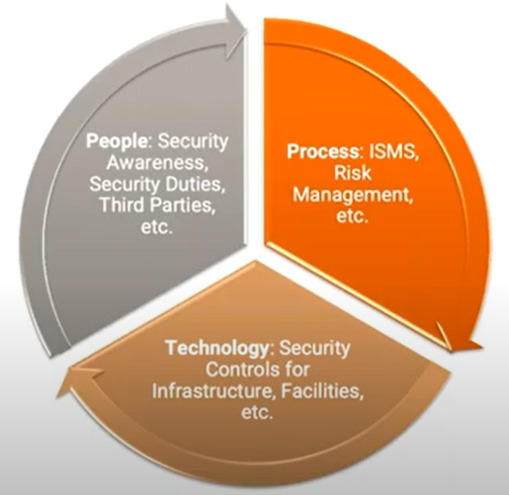
CS 3002 Information Security
Fall 2024
Week # 2 – Lecture # 4, 5, 6
27th - 29th Aug 2024
Dr. Aqsa Aslam

Slide 2
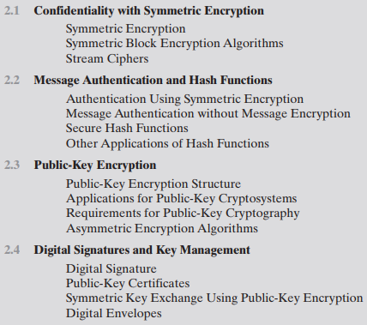
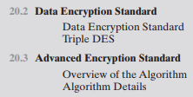

Possible Coverage before Midterm # 1
Topics from Chapter # 2, Chapter # 20 and Chapter # 21

Slide 3
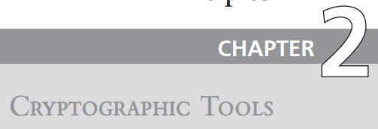


Slide 4
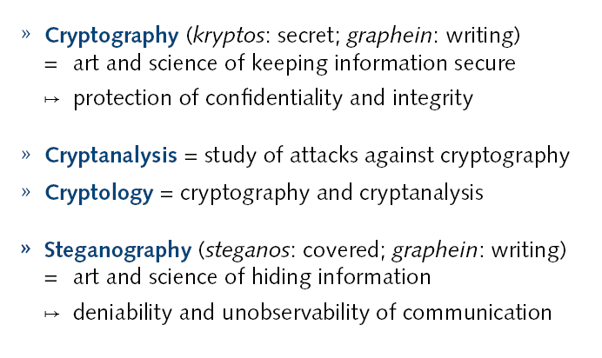



Cryptography

Slide 5
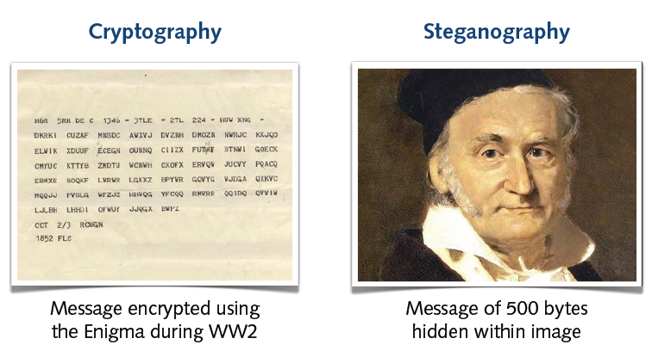
Examples
The Enigma machine enabled complex encryption with billions of code combinations, making German messages nearly unbreakable during WWII.

Slide 6
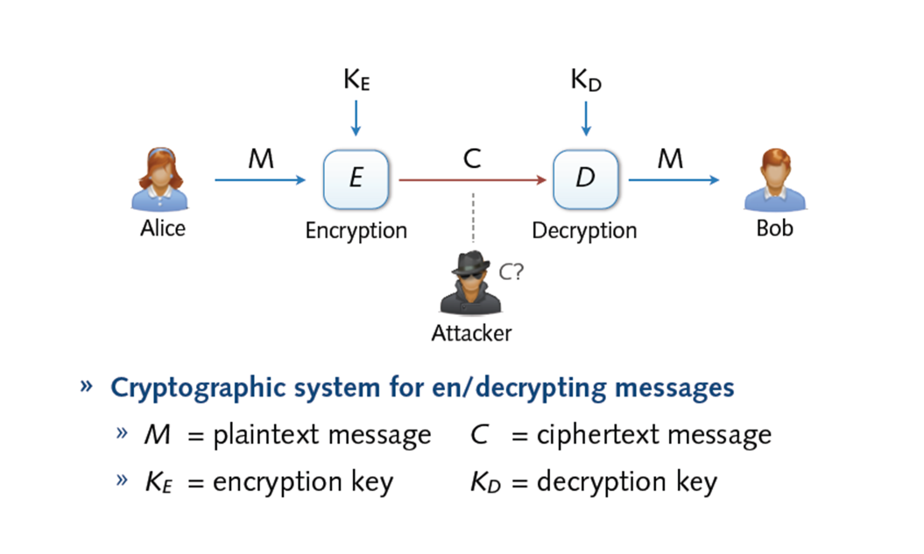
Cryptosystem

Slide 7
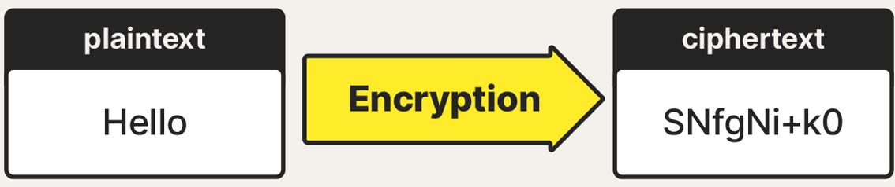
Symmetric Encryption
Encryption is the process of converting information or data into a code, especially to prevent unauthorized access.
Symmetric encryption is the universal technique for providing confidentiality for transmitted or stored data. Also referred to as conventional encryption or single-key encryption
Two requirements for secure use of symmetric encryption
Need a strong encryption algorithm:
We need a strong encryption method that even if someone knows how it works and has access to some encrypted messages, they still can’t figure out the original message or the key used to encrypt it.
Sender and receiver must have obtained copies of the secret key in a secure fashion and must keep the key secure
Notes:
The universal technique for providing confidentiality for transmitted or stored data is symmetric encryption.
This section introduces the basic concept of symmetric encryption. This is followed by an overview of the two most important symmetric encryption algorithms:
the Data Encryption Standard (DES)
the Advanced Encryption Standard (AES)
which are block encryption algorithms.
Finally, this section introduces the concept of symmetric stream encryption algorithms. Symmetric encryption, also referred to as conventional encryption or single-key
encryption, was the only type of encryption in use prior to the introduction of public-key encryption in the late 1970s.
Countless individuals and groups, from Julius Caesar to the
German U-boat force to present-day diplomatic, military, and commercial users, have
used symmetric encryption for secret communication. It remains the more widely used
of the two types of encryption.
There are two requirements for secure use of symmetric encryption:
1. We need a strong encryption algorithm. At a minimum, we would like the
algorithm to be such that an opponent who knows the algorithm and has
access to one or more ciphertexts would be unable to decipher the ciphertext
or figure out the key. This requirement is usually stated in a stronger form:
The opponent should be unable to decrypt ciphertext or discover the key even
if he or she is in possession of a number of ciphertexts together with the plaintext
that produced each ciphertext.
2. Sender and receiver must have obtained copies of the secret key in a secure
fashion and must keep the key secure. If someone can discover the key and
knows the algorithm, all communication using this key is readable.

Slide 8
Symmetric Encryption

Slide 9
Symmetric Encryption
A symmetric encryption scheme has five ingredients
Plaintext: This is the original message or data that is fed into the algorithm as input.
Encryption algorithm: The encryption algorithm performs various substitutions and transformations on the plaintext.
Secret key: The secret key is also input to the encryption algorithm. The exact substitutions and transformations performed by the algorithm depend on the key.
Ciphertext: This is the scrambled message produced as output. It depends on the plaintext and the secret key. For a given message, two different keys will produce two different ciphertexts.
Decryption algorithm: This is essentially the encryption algorithm run in reverse. It takes the ciphertext and the secret key and produces the original plaintext.

Slide 10
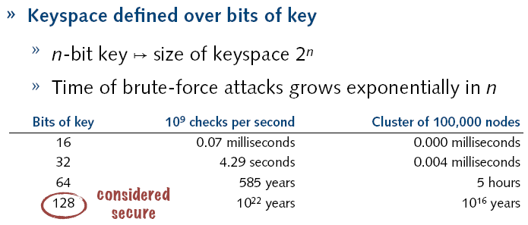
Symmetric Encryption
There are two general approaches to attacking a symmetric encryption scheme
Brute-force attack
Cryptanalysis
Brute-force attack:- A brute-force attack is when someone tries every possible key on an encrypted message (ciphertext) until they find the one that correctly turns it back into the original message (plaintext)
Key Attempts: On average, an attacker needs to try about half of all possible keys to find the correct one. If there are x different keys, they will usually succeed after trying x/2 keys.
Key Size: The larger the key, the more possible combinations there are, making it much harder and more time-consuming for an attacker to break the encryption.
Notes:
More information about plain text is needed to break in less time (i.e. trying half the keys):
Language of the plain text. This make it easy to recognize the result.
If the text message has been compressed before encryption, then recognition is more difficult.
A numerical file that has been compressed, the problem becomes even more difficult.

Slide 11
Symmetric Encryption
Cryptanalysis: Cryptanalysis refers to the process of analyzing information systems in order to understand hidden aspects of the systems.
Analyzing the Algorithm: Cryptanalytic attacks depend on understanding the encryption method and its weaknesses.
Using Known Information: Attackers might use general knowledge about the plaintext or specific pairs of plaintext and ciphertext to aid their attack.
Exploiting the Algorithm: These attacks try to figure out either the original plaintext or the encryption key.
Types of Cryptanalytic attacks
Ciphertext-only Attack: The attacker only has the scrambled (encrypted) message and tries to figure out what it says or the secret code (key) used to scramble it.
Known Plaintext Attack: The attacker knows both the original message and the scrambled version and uses this to figure out the secret code.
Chosen Plaintext Attack: The attacker can choose a message, get it scrambled, and use the scrambled version to learn about the secret code.
Chosen Ciphertext Attack: The attacker can choose a scrambled message, get it unscrambled, and use that to figure out the secret code.

Slide 12
Symmetric Block Encryption Algorithms
Types of Symmetric Encryption
Block Ciphers
Stream Ciphers
Symmetric Block Encryption Algorithms
DES and AES
Weaknesses of DES and Triple-DES
Data Encryption Standard (DES) Algorithms

Slide 13
Symmetric Block Encryption Algorithms
Types of Symmetric Encryption
Block Ciphers
Stream Ciphers
Symmetric Block Encryption Algorithms
DES and AES
Weaknesses of DES and Triple-DES
Data Encryption Standard (DES) Algorithms

Slide 14
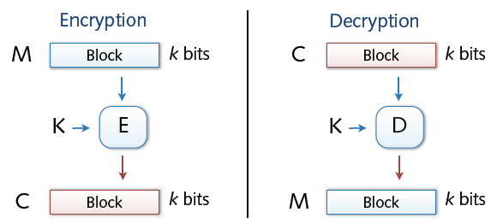
Symmetric Block Encryption Algorithms
Block Ciphers = processing of fixed-length blocks
Example: DES , AES
Block ciphers are the most common symmetric encryption algorithms.
Block ciphers encrypt plaintext in fixed-size blocks, producing equal-sized ciphertext blocks (e.g., 64 or 128 bit)
Padding of short messages, splitting of long messages
The algorithm processes longer plaintext amounts as a series of fixed-size blocks.

Slide 15
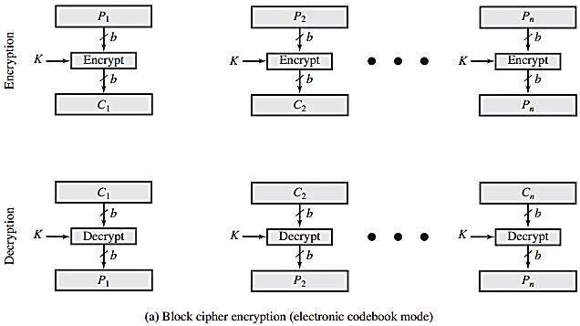
Symmetric Block Encryption Algorithms
Block Ciphers = processing of fixed-length blocks
Different modes of operations: ECB, CBC, CTR
ECB (Electronic Codebook) mode encrypts each block of plaintext independently, making identical plaintext blocks produce identical ciphertext blocks.
Vulnerable to pattern-based attacks.

Slide 16
Application of Block cipher
For applications that deal with blocks of data, such as:
File Transfer: Block ciphers encrypt files before transfer, ensuring secure transmission.
E-mail: Block ciphers secure the content of emails, protecting them from unauthorized access.
Database: Block ciphers encrypt sensitive data within databases, protecting it from breaches or unauthorized access.

Slide 17
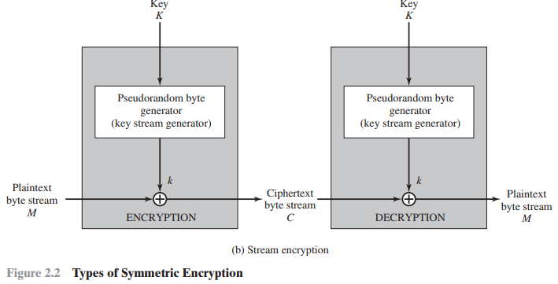
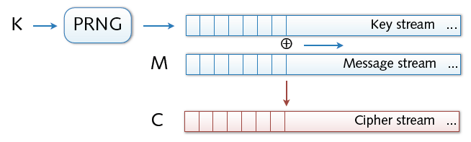
Symmetric Block Encryption Algorithms
Stream ciphers
Examples: RC4
Bit-wise encryption and decryption of data
Application of pseudo-random number generator (PRG)
XOR operation on pseudo-random keystream
Security solely depends on randomness of PRG

Slide 18
Application Stream cipher
Stream ciphers are particularly well-suited for applications where data is transmitted in a continuous stream, such as over data communication channels or web links.
Data Communications: Stream ciphers are used in securing real-time data communications, such as video conferencing, VoIP calls, or any application where data is continuously transmitted.
Web Links: In secure web traffic (HTTPS), stream ciphers can be used to encrypt the data flowing between the user's browser and the web server, ensuring that sensitive information like passwords or credit card numbers remains confidential.

Slide 19
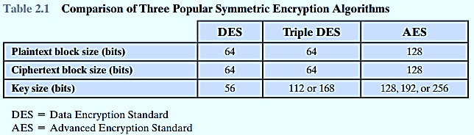
Symmetric Block Encryption Algorithms
The most important symmetric algorithms, all of which are block ciphers, are the:
Data Encryption Standard (DES),
Triple DES (3DES)
The Advanced Encryption Standard (AES)

Slide 20
Symmetric Block Encryption Algorithms
The Data Encryption Standard (DES)
DES (Data Encryption Standard) was the most widely used encryption scheme,
DES operates on a 64-bit plaintext block with a 56-bit key, producing a 64-bit ciphertext block.
Concerns about DES:
Algorithm Security:
DES has been extensively studied, and numerous attempts have been made to find weaknesses in the algorithm.
Despite many efforts, no fatal weakness has been discovered in DES itself.
Key Length:
The 56-bit key length allows for 2^56 (approximately 7.2 x 10^16) possible keys.
This key length is considered inadequate with modern computing power.
Modern multicore processors can attempt about 1 billion (10^9) key combinations per second, making it feasible to break DES with brute-force attacks.
Contemporary supercomputers could potentially perform around 10^13 encryptions per second, further reducing the time needed to break DES.
Both Intel and AMD have introduced hardware-based instructions to speed up encryption using AES, indicating a shift towards more secure algorithms.
Tests on modern Intel machines show an encryption rate of about half a billion encryptions per second.

Slide 21
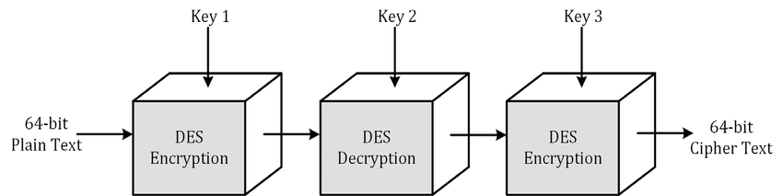
Symmetric Block Encryption Algorithms
Triple DES (3DES)
3DES extends the life of DES by applying the DES algorithm three times with either two or three unique keys.
Provides a key size of 112 bits or 168 bits.
168-bit Key Length: Provides enhanced security by overcoming the brute-force vulnerabilities of DES.
Proven Algorithm: Uses the same encryption algorithm as DES, which has been extensively analyzed and tested.
No Effective Cryptanalytic Attacks: No effective attacks have been found that exploit the algorithm itself, only brute force.
High Confidence in Security: 3DES is highly resistant to cryptanalysis.
Standardized Encryption: If security were the only consideration, 3DES would be a strong choice for a standardized encryption algorithm for many years.
Drawbacks of 3DES:
Requires three times as many calculations as DES, making it slower.
Designed for outdated hardware, leading to inefficient software implementation.
Uses a relatively small block size (64 bit), which is less efficient and secure.

Slide 22
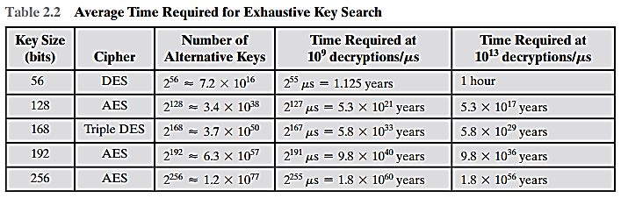
Notes:
Time Required at 10910^9109 Decryptions/Second: This is how long it would take to break the encryption if we could try 1 billion keys every second.
Time Required at 101310^{13}1013 Decryptions/Second: This is how long it would take to break the encryption if we could try 10 trillion keys every second.

Slide 23

Coverage from slides provided by Course Coordinator

Slide 24
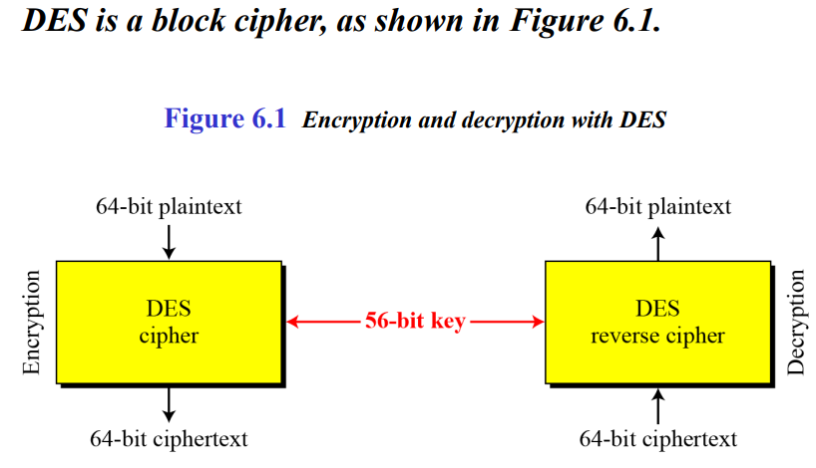

Slide 25
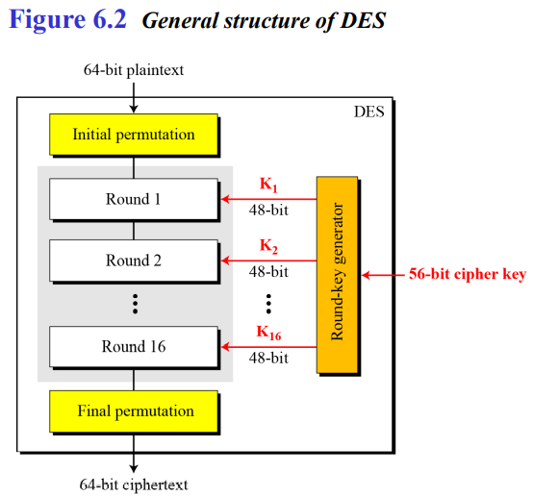
Data Encryption Standard (DES)
The DES algorithm can be described as follows.
DES is based on Feistal Network
The plaintext is 64 bits in length
The key is 56 bits in length
There are 16 rounds of processing.
From the original 56-bit key
16subkeys are generated (ki= 48 bit)
one of which is used for each round.

Slide 26
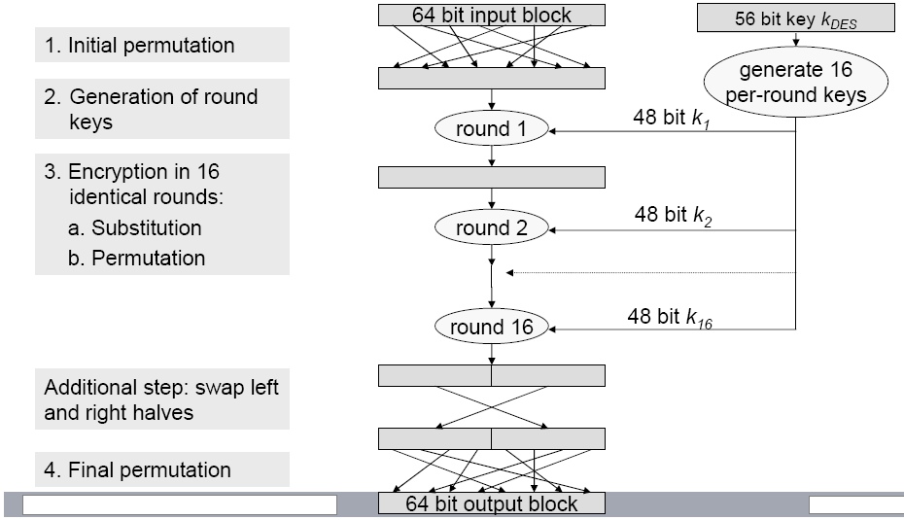
Data Encryption Standard (DES)
Encryption process:

Slide 27
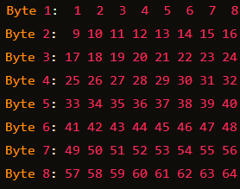
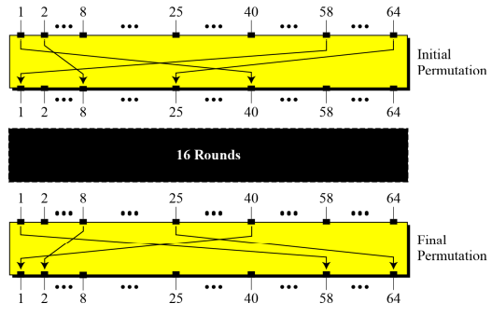
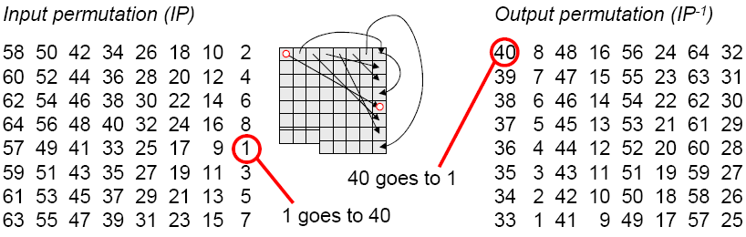
Step 1 & 4: Initial and Final Permutation
Initial Permutation (IP):Rearranges the bits of the original data block before encryption begins.
Consider the 64-bit block as 8 bytes (each byte has 8 bits).
Arrange these 8 bytes into an 8x8 matrix (each row represents one byte)
Initial Permutation → spread (or diffuse) the bits across different bytes to enhance security.
Final Permutation: Rearranges the bits of the encrypted data block after all DES rounds
to produce the final encrypted data.
Rule: In the initial permutation, the 58th bit in the input becomes the first bit in the output. Similarly, in the final permutation, the first bit in the input becomes the 58th bit in the output.
Rule: In the initial permutation, the 58th bit in the input becomes the first bit in the output. Similarly, in the final permutation, the first bit in the input becomes the 58th bit in the output.

Slide 28
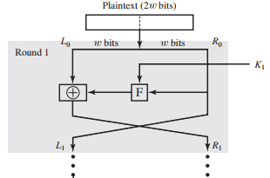
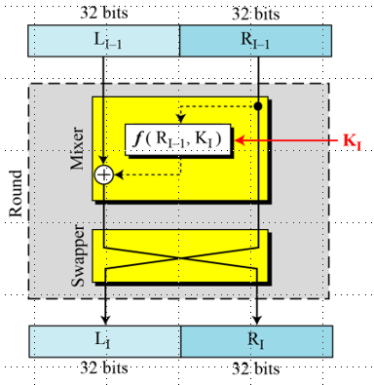
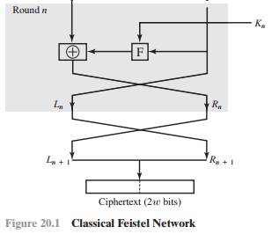

Step 3: Performing 16 identical rounds
Textbook page 631-631

Slide 29
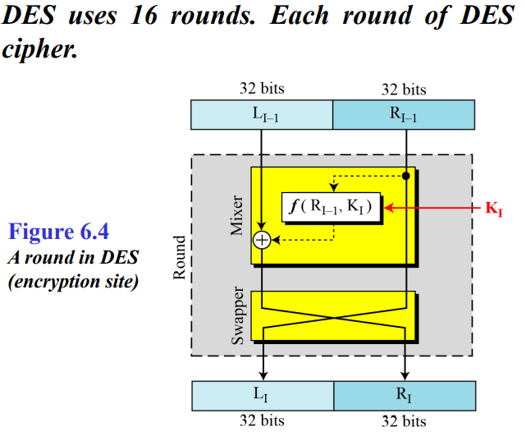
Step 3: Performing 16 identical rounds
Splitting: The plaintext block is divided into two halves, typically denoted as Li (left) and Ri (right)
Round Function: The Feistel cipher operates through multiple rounds. In each round, a function F is applied to one half of the block, combined with the other half, and then the halves are swapped. F is cipher function, i.e. combination of substitution and permutation
For each round i, compute: Li+1 as Ri, and Ri+1 as Li ⊕ F(Ri, Ki)
Final Output: After completing all rounds, the final ciphertext is the concatenation of Ln and Rn, where n is the number of rounds.

Slide 30
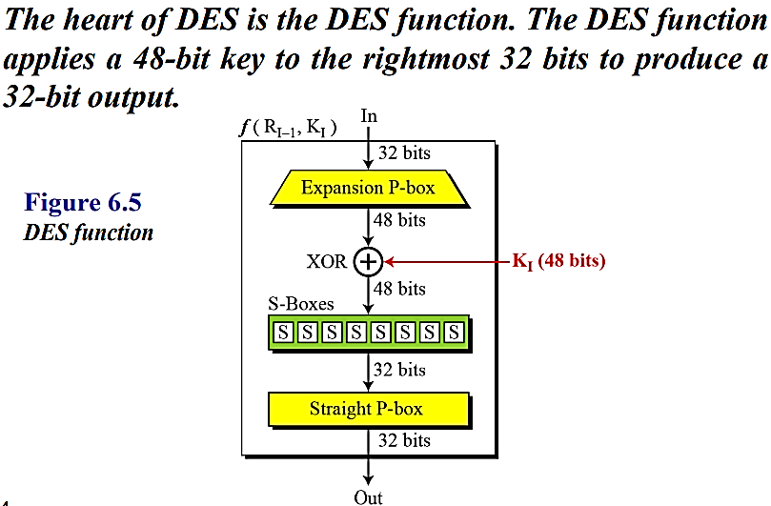
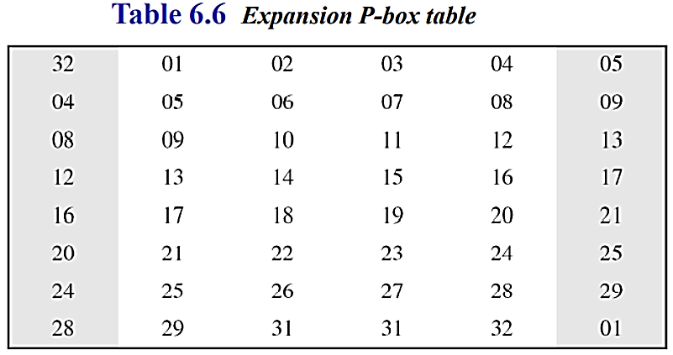
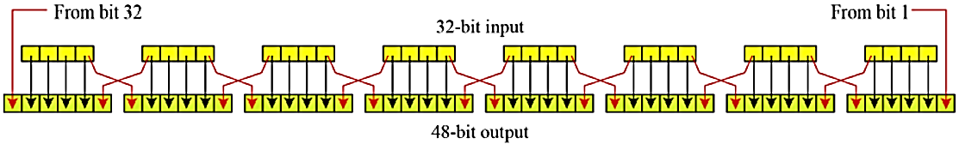
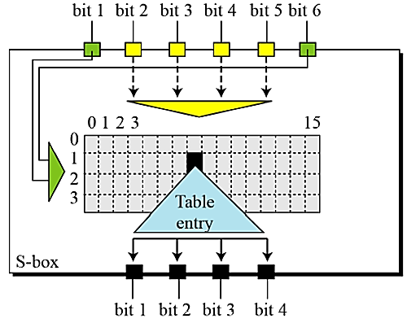
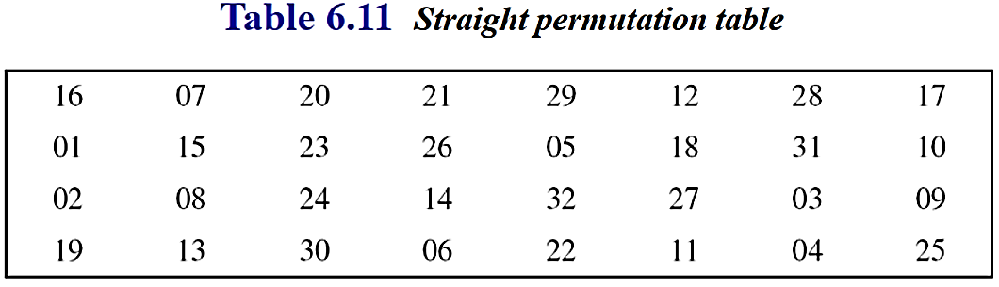
By duplicating bits
Details on next slide
Details on next slide

Slide 31
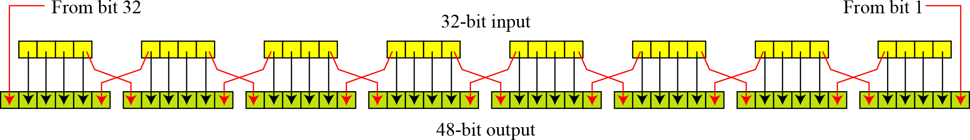
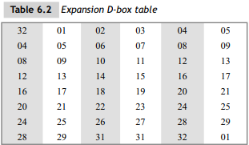
Expansion P-box
Since R_{I−1} is a 32-bit input and K_{I} is a 48-bit key, we first need to expand R_{I−1} to 48 bits.
Figure 6.6 Expansion permutation
Note: The number of output ports is 48, but the value range is only 1 to 32. Some of the inputs go to more than one output.

Slide 32
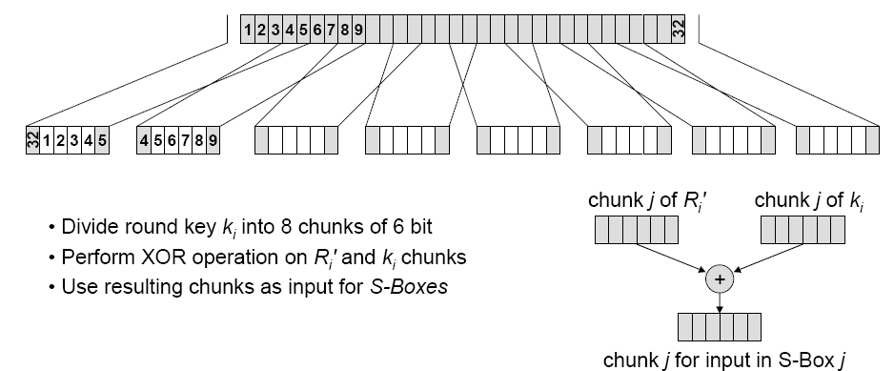

XOR: Key and Expanded R bits

Slide 33
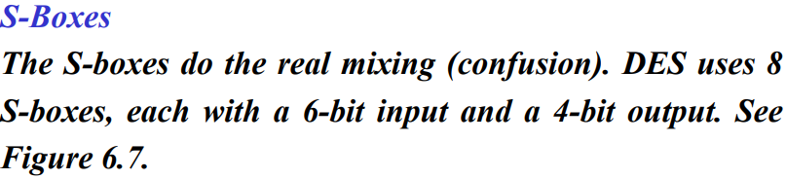
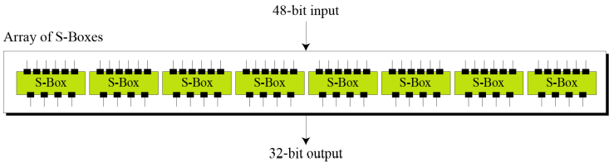

(Substitution Boxes)
* There are 8 S-Boxes. Each one has its own table.

Slide 34
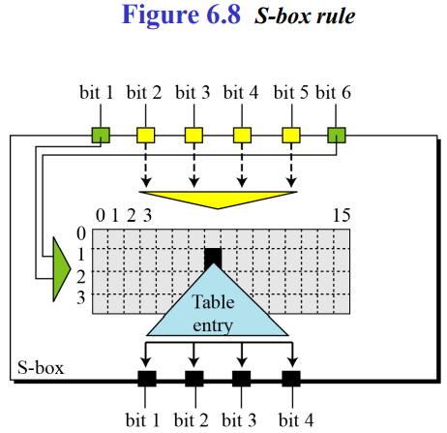
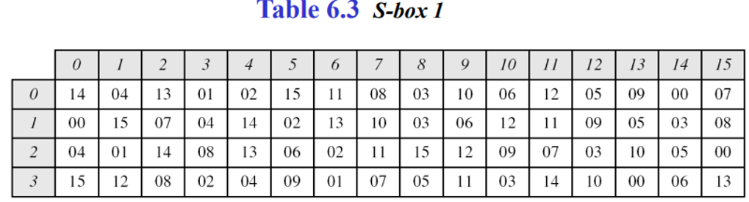
The S-Boxes
Each 8-S-boxes has a 6-bit input and a 4-bit output.
The values of the inputs (row number and column number)
Each 6-bit piece uses as an address in the S-boxes where the first and last bits are used to address the i^{th} row and the middle four bits to address the j^{th} column in the S-boxes.
The output of each S-box is 4-bit length piece. The output of all eight S-boxes is then combined into 32 bit section
* Each S-box has its own table.

Slide 35
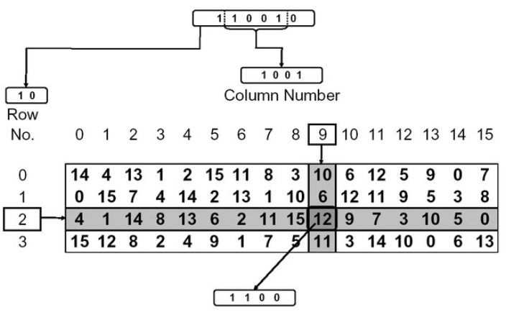
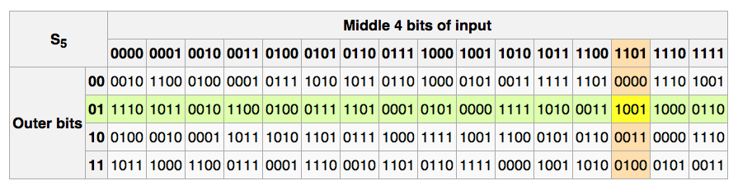
The S-Boxes
8 4 2 1

Slide 36
Straight P-box
The output from the S-boxes is then rearranged according to a fixed permutation table.
This permutation helps in further diffusion of the data by shuffling the bits.

Slide 37
Confusion and Diffusion
Confusion ensures that the relationship between the key and the ciphertext is complex and non-linear, making it difficult for an attacker to determine the key from the ciphertext. (It should have a high level of confusion to thwart key recovery attempts.)
By substitution and key mixing
Example: In DES, the S-boxes perform substitution on 6-bit blocks of data to create a 4-bit output. This substitution step is designed to be complex and non-linear, contributing to confusion.
Diffusion ensures that the influence of each plaintext bit is spread across many bits in the ciphertext, making it difficult to deduce any individual bit of plaintext from the ciphertext. (It should achieve good diffusion to prevent plaintext patterns from being detected in the ciphertext.)
By Permutation and mixing function
Example: In DES, after the S-boxes, the output bits are permuted (straight permutation) to ensure that the influence of each bit is spread throughout the final ciphertext.

Slide 38
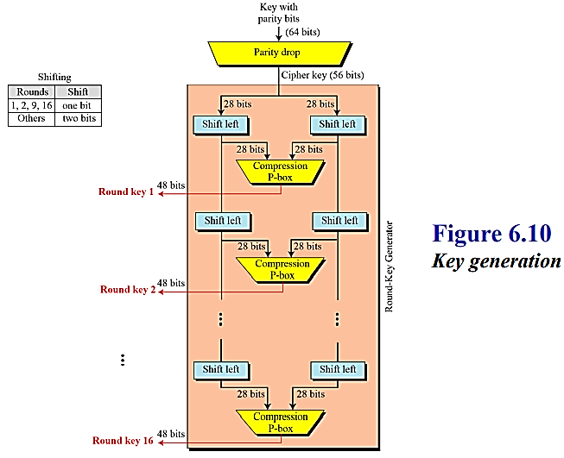
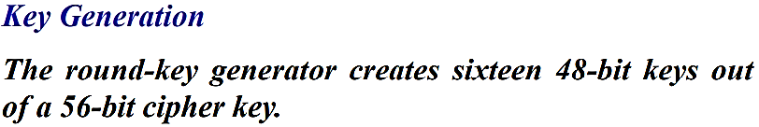

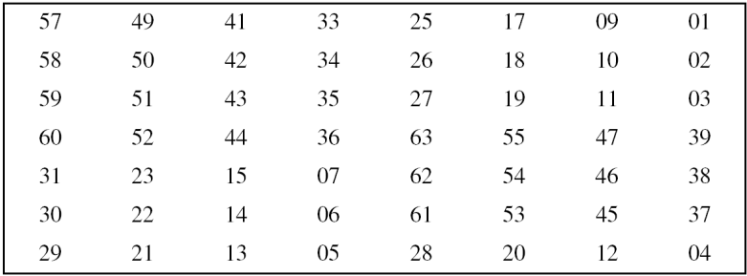
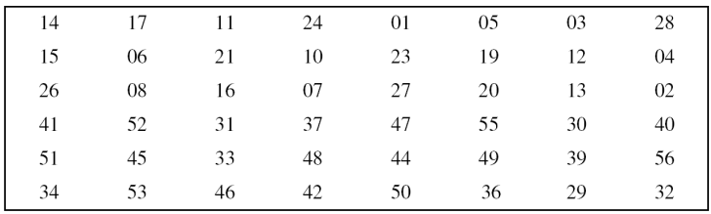
Step 2: Generation of Round Keys

Slide 39
Step 2: Generation of Round Keys
Initial Key Preparation:-
Effective 56-bit key is what DES uses to generate the round keys and perform the encryption.
The 56-bit key is permuted using a predefined table.
Splitting the Key:
The 56-bit key is divided into two halves:
Left Half (C0): The first 28 bits.
Right Half (D0): The last 28 bits.
Key Shifting:
For each of the 16 rounds, the two halves (C and D) are shifted left by 1 or 2 bits depending on the round
Rounds 1, 2, 9, 16: 1-bit left shift.
All other rounds (3-8, 10-15): 2-bit left shift.
Compression P-Box:
After shifting, the 28-bit halves (C and D) are combined back into a 56-bit key.
The Key-Compression Table (Table 6.14) then compresses this 56-bit key into a 48-bit round key.
This table specifies which bits from the combined 56 bits are selected and in what order to form the 48-bit key.
Ci: bits 9, 18, 22, and 25 are discarded (remaining: 24 bits)
Di: bits 35, 38, 43, and 54 are discarded (remaining: 24 bits)
The compression process reduces the key size and introduces further bit rearrangement to enhance security.

